Slide 1
Jarrell Independent School District
3Q21
Demographic Report

Slide 2
Annual Enrollment Change
Year (Oct.) | EE | PK | K | 1st | 2nd | 3rd | 4th | 5th | 6th | 7th | 8th | 9th | 10th | 11th | 12th | Total | Total Growth | % Growth
2017/18 | 10 | 80 | 133 | 146 | 133 | 127 | 131 | 120 | 119 | 135 | 108 | 124 | 124 | 113 | 100 | 1,703
2018/19 | 13 | 90 | 142 | 153 | 154 | 138 | 144 | 146 | 141 | 129 | 142 | 136 | 126 | 122 | 121 | 1,897 | 194 | 11.4%
2019/20 | 5 | 108 | 174 | 164 | 171 | 161 | 168 | 159 | 159 | 169 | 143 | 172 | 125 | 120 | 104 | 2,102 | 205 | 10.8%
2020/21 | 4 | 87 | 182 | 198 | 181 | 171 | 170 | 184 | 167 | 170 | 176 | 183 | 177 | 137 | 118 | 2,305 | 203 | 9.7%
2021/22 | 9 | 143 | 223 | 241 | 244 | 224 | 220 | 212 | 210 | 204 | 192 | 218 | 191 | 207 | 140 | 2,878 | 573 | 24.9%
Yellow Box = largest grade per year
Green Box = second largest grade per year
Year | EE | PK | K | 1st | 2nd | 3rd | 4th | 5th | 6th | 7th | 8th | 9th | 10th | 11th | 12th | Elem | MS | HS
3 year avg | 1.145 | 1.216 | 1.166 | 1.206 | 1.151 | 1.094 | 1.187 | 1.149 | 1.094 | 1.163 | 1.093 | 1.243 | 0.997 | 1.073 | 0.953 | 1.159 | 1.117 | 1.066
2018/19 | 1.300 | 1.125 | 1.068 | 1.150 | 1.055 | 1.038 | 1.134 | 1.115 | 1.175 | 1.084 | 1.052 | 1.259 | 1.016 | 0.984 | 1.071 | 1.093 | 1.104 | 1.083
2019/20 | 0.385 | 1.200 | 1.225 | 1.155 | 1.118 | 1.045 | 1.217 | 1.104 | 1.089 | 1.199 | 1.109 | 1.211 | 0.919 | 0.952 | 0.852 | 1.144 | 1.132 | 0.984
2020/21 | 0.800 | 0.806 | 1.046 | 1.138 | 1.104 | 1.000 | 1.056 | 1.095 | 1.050 | 1.069 | 1.041 | 1.280 | 1.029 | 1.096 | 0.983 | 1.073 | 1.054 | 1.097
2021/22 | 2.250 | 1.644 | 1.225 | 1.324 | 1.232 | 1.238 | 1.287 | 1.247 | 1.141 | 1.222 | 1.129 | 1.239 | 1.044 | 1.169 | 1.022 | 1.259 | 1.164 | 1.118
Jarrell ISD increased by 573 students this fall for a 24.9% growth rate
The district continues to see record braking growth due to extreme housing development growth in the district

Slide 3
Austin New Home Ranking Report ISD Ranked by Annual Closings – 3Q21
Rank | District Name | Annual Starts | Annual Closings | Inventory | VDL | Future
1 | Leander ISD | 3,172 | 2,682 | 1,784 | 3,033 | 7,521
2 | Georgetown ISD | 2,964 | 2,423 | 1,699 | 2,895 | 17,869
3 | Liberty Hill ISD | 2,626 | 2,092 | 4th | 1,926 | 10,792
4 | Hays CISD | 3,095 | 1,988 | 2,013 | 2,990 | 42,231
5 | Pflugerville ISD | 2,011 | 1,662 | 7th | 1,003 | 8,427
6 | Austin ISD | 1,382 | 1,517 | 1,496 | 1,217 | 11,160
7 | Hutto ISD | 1,738 | 1,346 | 1,006 | 1,373 | 7,410
8 | Del Valle ISD | 1,452 | 1,341 | 717 | 980 | 23,481
9 | Manor ISD | 1,243 | 1,333 | 532 | 1,385 | 15,353
10 | Jarrell ISD* | 1,191 | 1,078 | 440 | 1,251 | 12,543
11 | Dripping Springs ISD | 1,199 | 965 | 720 | 1,060 | 7,441
12 | Round Rock ISD | 743 | 738 | 591 | 1,092 | 5,227
13 | Lake Travis ISD | 1,004 | 710 | 795 | 1,056 | 4,102
14 | Bastrop ISD | 1,124 | 684 | 634 | 2,388 | 16,867
15 | Elgin ISD | 432 | 436 | 158 | 381 | 8,769
16 | San Marcos CISD | 692 | 431 | 540 | 1,150 | 6,048
17 | Lago Vista ISD | 257 | 169 | 170 | 564 | 3,943
18 | Taylor ISD | 261 | 160 | 169 | 94 | 1,153
19 | Lockhart ISD | 75 | 54 | 42 | 1 | 16,396
20 | Eanes ISD | 22 | 12 | 20 | 91 | 49
* Based on additional Templeton Demographics housing research
**Includes Age-Restricted subdivisions

Slide 4
District New Home Starts and Closings
Starts | 2015 | 2016 | 2017 | 2018 | 2019 | 2020 | 2021 |  | Closings | 2015 | 2016 | 2017 | 2018 | 2019 | 2020 | 2021
1Q | 49 | 36 | 44 | 51 | 55 | 155 | 313 |  | 1Q | 52 | 45 | 85 | 72 | 85 | 126 | 242
2Q | 66 | 62 | 111 | 121 | 129 | 135 | 339 |  | 2Q | 65 | 45 | 53 | 32 | 97 | 192 | 263
3Q | 37 | 82 | 103 | 112 | 248 | 240 | 288 |  | 3Q | 68 | 62 | 109 | 99 | 107 | 166 | 350
4Q | 45 | 86 | 73 | 81 | 160 | 251 | - |  | 4Q | 38 | 45 | 98 | 88 | 180 | 223 | -
Total | 197 | 266 | 331 | 365 | 592 | 781 | 940 |  | Total | 223 | 197 | 345 | 291 | 469 | 707 | 855

Slide 5
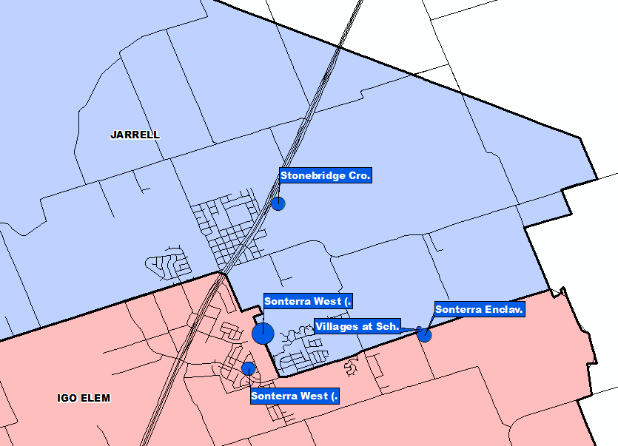
Annual Closing Distribution
Top 10 Subdivisions - 3Q21 (Ranked by Annual Closings)
Rank | Subdivision | Annual Closings | Quarter Closings | VDL | Future
1 | Sonterra West (JARRELL) | 538 | 121 | 0 | 1,179
2 | Stonebridge Crossing | 145 | 82 | 282 | 0
3 | Sonterra Enclave | 135 | 44 | 0 | 0
4 | Sonterra West (IGO) | 107 | 0 | 18 | 1,181
5 | Villages at Schwertner Ranch | 88 | 84 | 73 | 708
 | TOTAL | 1,013 | 331 | 373 | 3,068
Notes:
Over 65% of all closings in the top 6

Slide 6
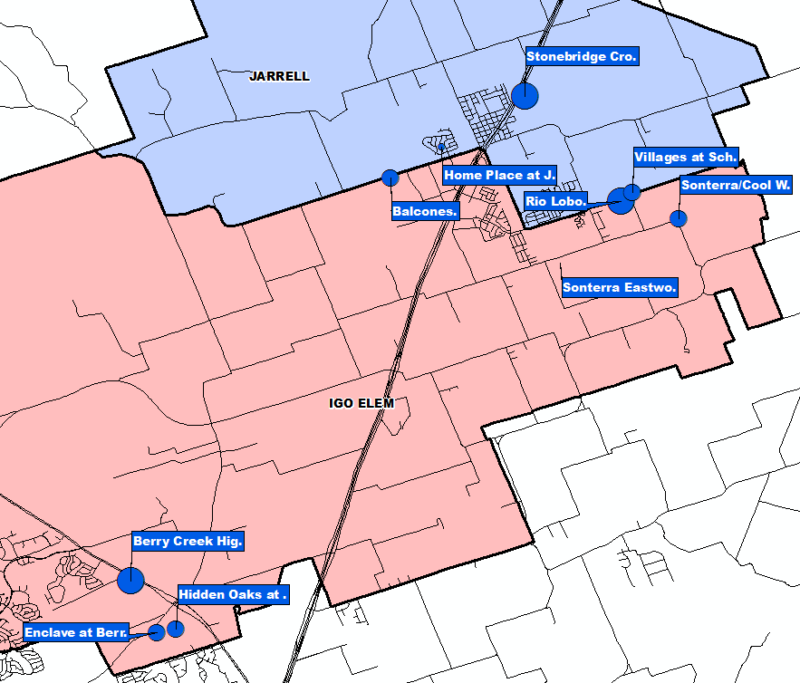
VDL Distribution
Top 10 Subdivisions - 3Q21 (Ranked by Future Inventory)
Rank | Subdivision | Annual Closings | Quarter Closings | VDL | Future
1 | Sonterra Eastwood | 0 | 0 | 318 | 815
2 | Stonebridge Crossing | 145 | 82 | 282 | 0
3 | Rio Lobo | 0 | 0 | 128 | 109
4 | Berry Creek Highlands | 0 | 0 | 111 | 1,058
5 | Villages at Schwertner Ranch | 88 | 84 | 73 | 708
6 | Balcones | 0 | 0 | 72 | 0
7 | Hidden Oaks at Berry Creek | 9 | 4 | 69 | 88
8 | Sonterra Cool Water | 0 | 0 | 68 | 1,367
9 | Enclave at Berry Creek | 0 | 0 | 58 | 0
10 | Home Place at Jarrell | 25 | 6 | 47 | 0
 |  | 267 | 176 | 1,226 | 4,145

Slide 7
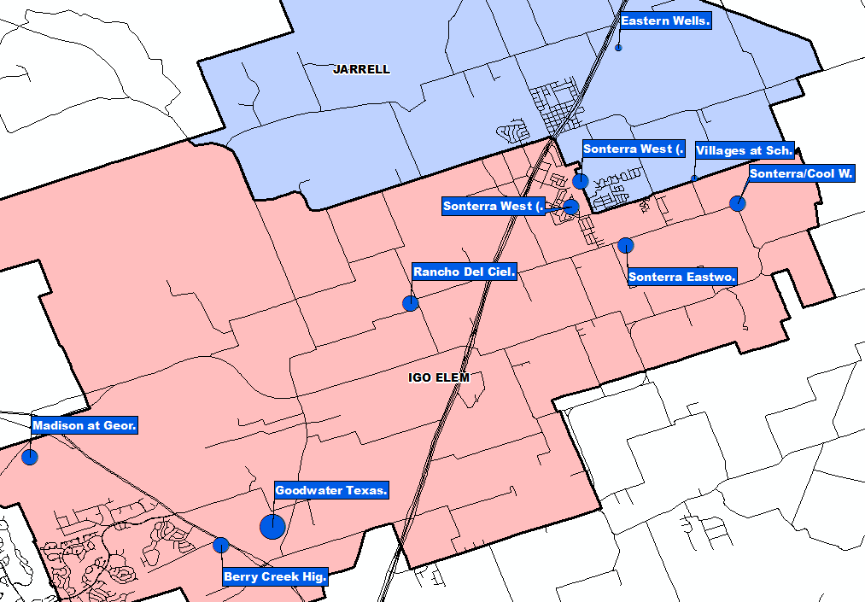
Futures Distribution
Top 10 Subdivisions - 3Q21 (Ranked by Future Inventory)
Rank | Subdivision | Annual Closings | Quarter Closings | VDL | Future
1 | Goodwater Texas | 0 | 0 | 0 | 2,500
2 | Sonterra Cool Water | 0 | 0 | 68 | 1,367
3 | Sonterra West (IGO) | 107 | 0 | 18 | 1,181
4 | Sonterra West (JARRELL) | 538 | 121 | 0 | 1,179
5 | Berry Creek Highlands | 0 | 0 | 111 | 1,058
6 | Rancho Del Cielo | 0 | 0 | 0 | 941
7 | Madison at Georgetown | 0 | 0 | 0 | 936
8 | Sonterra Eastwood | 0 | 0 | 318 | 815
9 | Eastern Wells | 0 | 0 | 0 | 712
10 | Villages at Schwertner Ranch | 88 | 84 | 73 | 708
 |  | 733 | 205 | 588 | 11,397

Slide 8
District Housing Overview by Elementary Zone
Elementary Zone | Annual Starts | Quarter Starts | Annual Closings | Quarter Closings | Under Construction | Inventory | VDL | Futures
IGO | 363 | 169 | 282 | 57 | 201 | 221 | 849 | 9,579
JARRELL | 828 | 119 | 796 | 293 | 182 | 219 | 402 | 2,964
Grand Total | 1,191 | 288 | 1,078 | 350 | 383 | 440 | 1,251 | 12,543

Slide 9
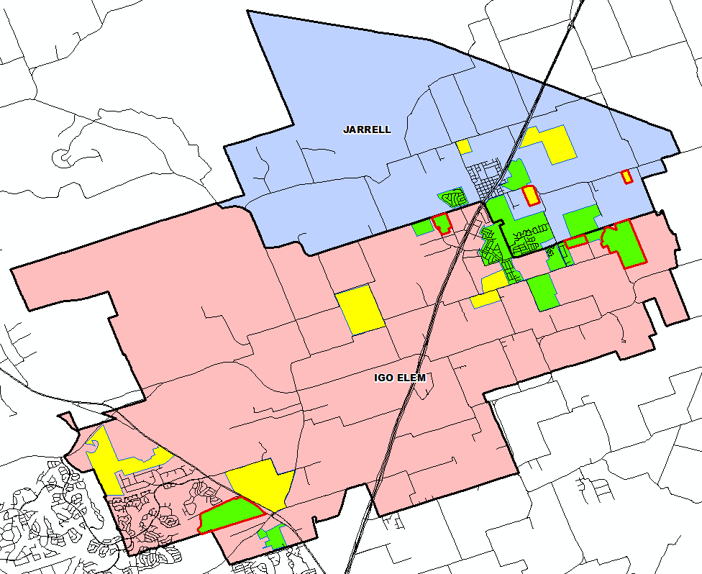
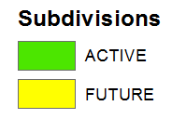
District Housing Overview
The district has 15 actively building subdivisions
Within Jarrell ISD there are 9 future subdivisions
Of these, groundwork is underway on more than 1,960 lots within 6 subdivisions

Slide 10
Ten Year Forecast by Grade Level
Year (Oct.) | EE | PK | K | 1st | 2nd | 3rd | 4th | 5th | 6th | 7th | 8th | 9th | 10th | 11th | 12th | Total | Total Growth | % Growth
2017/18 | 10 | 80 | 133 | 146 | 133 | 127 | 131 | 120 | 119 | 135 | 108 | 124 | 124 | 113 | 100 | 1,703
2018/19 | 13 | 90 | 142 | 153 | 154 | 138 | 144 | 146 | 141 | 129 | 142 | 136 | 126 | 122 | 121 | 1,897 | 194 | 11.4%
2019/20 | 5 | 108 | 174 | 164 | 171 | 161 | 168 | 159 | 159 | 169 | 143 | 172 | 125 | 120 | 104 | 2,102 | 205 | 10.8%
2020/21 | 4 | 87 | 182 | 198 | 181 | 171 | 170 | 184 | 167 | 170 | 176 | 183 | 177 | 137 | 118 | 2,305 | 203 | 9.7%
2021/22 | 9 | 143 | 223 | 241 | 244 | 224 | 220 | 212 | 210 | 204 | 192 | 218 | 191 | 207 | 140 | 2,878 | 573 | 24.9%
2022/23 | 21 | 185 | 263 | 268 | 278 | 281 | 265 | 256 | 259 | 263 | 245 | 250 | 229 | 208 | 211 | 3,482 | 604 | 21.0%
2023/24 | 23 | 210 | 309 | 316 | 308 | 323 | 330 | 312 | 305 | 311 | 302 | 319 | 263 | 245 | 208 | 4,084 | 602 | 17.3%
2024/25 | 23 | 235 | 351 | 364 | 357 | 348 | 365 | 383 | 361 | 348 | 339 | 386 | 327 | 260 | 240 | 4,687 | 603 | 14.8%
2025/26 | 23 | 260 | 405 | 411 | 425 | 413 | 402 | 424 | 417 | 412 | 374 | 438 | 396 | 324 | 255 | 5,379 | 692 | 14.8%
2026/27 | 23 | 275 | 459 | 478 | 465 | 481 | 474 | 467 | 462 | 459 | 447 | 483 | 449 | 392 | 318 | 6,132 | 753 | 14.0%
2027/28 | 23 | 295 | 512 | 537 | 536 | 519 | 544 | 536 | 502 | 504 | 497 | 536 | 473 | 445 | 384 | 6,843 | 711 | 11.6%
2028/29 | 23 | 325 | 563 | 594 | 587 | 582 | 571 | 599 | 576 | 547 | 545 | 627 | 552 | 468 | 436 | 7,595 | 752 | 11.0%
2029/30 | 23 | 345 | 605 | 649 | 638 | 637 | 640 | 628 | 644 | 628 | 592 | 682 | 634 | 546 | 459 | 8,350 | 755 | 9.9%
2030/31 | 23 | 360 | 651 | 681 | 697 | 693 | 701 | 704 | 675 | 702 | 680 | 733 | 687 | 628 | 535 | 9,150 | 800 | 9.6%
2031/32 | 23 | 360 | 686 | 734 | 718 | 758 | 763 | 771 | 757 | 736 | 760 | 850 | 745 | 680 | 615 | 9,956 | 806 | 8.8%
Yellow box = largest grade per year
Green box = second largest grade per year

Slide 11
Ten Year Forecast by Campus
 |  |  | Fall | ENROLLMENT PROJECTIONS
Campus | Capacity | 2020/21 | 2021/22 | 2022/23 | 2023/24 | 2024/25 | 2025/26 | 2026/27 | 2027/28 | 2028/29 | 2029/30 | 2030/31 | 2031/32
Igo Elementary | 800 | 720 | 849 | 1,000 | 1,177 | 1,385 | 1,624 | 1,903 | 2,197 | 2,440 | 2,676 | 2,907 | 3,125
Jarrell Elementary | 608 | 457 | 667 | 817 | 954 | 1,041 | 1,139 | 1,219 | 1,305 | 1,404 | 1,489 | 1,603 | 1,688
ELEMENTARY SCHOOL TOTAL | 1,408 | 1,177 | 1,516 | 1,817 | 2,131 | 2,426 | 2,763 | 3,122 | 3,502 | 3,844 | 4,165 | 4,510 | 4,813
Elementary Absolute Change |  | 67 | 339 | 301 | 314 | 295 | 337 | 359 | 380 | 342 | 321 | 345 | 303
Elementary Percent Change |  | 6.04% | 28.80% | 19.85% | 17.28% | 13.84% | 13.89% | 12.99% | 12.17% | 9.77% | 8.35% | 8.28% | 6.72%
Jarrell Middle School | 764/1,004 | 513 | 606 | 767 | 918 | 1,048 | 1,203 | 1,368 | 1,503 | 1,668 | 1,864 | 2,057 | 2,253
MIDDLE SCHOOL TOTAL |  | 513 | 606 | 767 | 918 | 1,048 | 1,203 | 1,368 | 1,503 | 1,668 | 1,864 | 2,057 | 2,253
Middle School Absolute Change |  | 42 | 93 | 161 | 151 | 130 | 155 | 165 | 135 | 165 | 196 | 193 | 196
Middle School Percent Change |  | 8.92% | 18.13% | 26.57% | 19.69% | 14.16% | 14.79% | 13.72% | 9.87% | 10.98% | 11.75% | 10.35% | 9.53%
Jarrell High School | 995/1,258 | 615 | 756 | 898 | 1,035 | 1,213 | 1,413 | 1,642 | 1,838 | 2,083 | 2,321 | 2,583 | 2,890
HIGH SCHOOL TOTAL |  | 615 | 756 | 898 | 1,035 | 1,213 | 1,413 | 1,642 | 1,838 | 2,083 | 2,321 | 2,583 | 2,890
High School Absolute Change |  | 94 | 141 | 142 | 137 | 178 | 200 | 229 | 196 | 245 | 238 | 262 | 307
High School Percent Change |  | 18.04% | 22.93% | 18.78% | 15.26% | 17.20% | 16.49% | 16.21% | 11.94% | 13.33% | 11.43% | 11.29% | 11.89%
DISTRICT TOTALS |  | 2,305 | 2,878 | 3,482 | 4,084 | 4,687 | 5,379 | 6,132 | 6,843 | 7,595 | 8,350 | 9,150 | 9,956
District Absolute Change |  | 203 | 573 | 604 | 602 | 603 | 692 | 753 | 711 | 752 | 755 | 800 | 806
District Percent Change |  | 9.66% | 24.86% | 20.99% | 17.29% | 14.76% | 14.76% | 14.00% | 11.59% | 10.99% | 9.94% | 9.58% | 8.81%
Yellow box = over 105% capacity
Green box = within 5% capacity

Slide 12
Key Takeaways
Jarrell ISD increased by 573 students this fall for a 24.9% growth rate
The district has 15 actively building subdivisions and 9 future subdivisions
JISD is on pace to close more than 1,100 homes in 2021
Groundwork is underway on more than 1,960 lots
The district will likely see 1,200 to 1,400 new homes a year for the next 3 to 5 years
Jarrell ISD can expect to enroll more than 6,100 students by 2026/27 and almost 10,000 by 2031/32

